Slide 1
Chapter 9
Week 6
Network Management Tools, Systems, and Engineering
N.B: Do not consider slides from 37 to 96 (i.e., MIB Engineering and NMS design is NOT considered)
Notes:
*

Slide 2
Basic Network Software Tools
Chapter 9 Network Management Tools, Systems, and Engineering
Status monitoring tools
Traffic monitoring tools
Route monitoring tools
  Notes
Basic tools are available as:
  Part of the Operating System
  Add-on applications
Numerous basic tools are either a part of the OS or are available as add-on applications that aid in
obtaining network parameters or in the diagnosis of network problems. We will describe some of the
more popular ones here under the three categories of status monitoring, traffic monitoring, and route monitoring.
Notes:
*

Slide 3
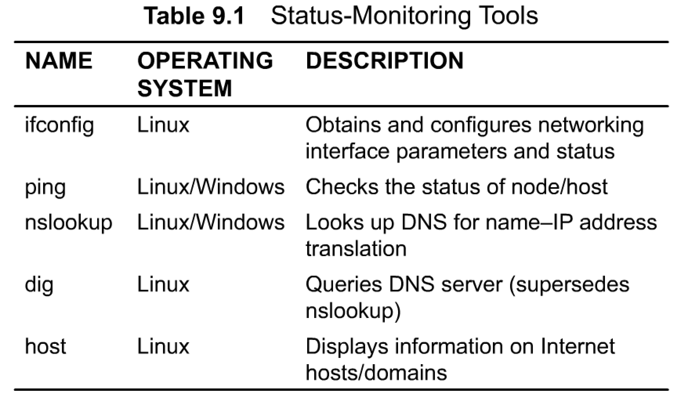
Status Monitoring Tools
Chapter 9 Network Management Tools, Systems, and Engineering
Table 9. 1 lists some of the network status-monitoring tools that are available
in the Linux/UNIX and Microsoft Windows (XP and Vista) environments.
The command ifconfig on a UNIX system is used to assign an address to a network interface or to
configure network interface parameters.
Notes:
*

Slide 4
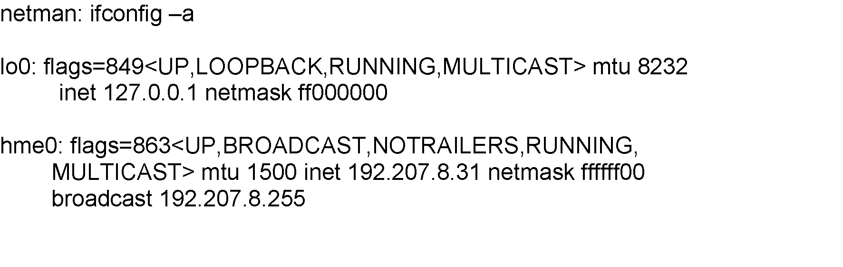
ifConfig
Chapter 9 Network Management Tools, Systems, and Engineering
Used to assign/read an address to/of an interface
Option -a is to display all interfaces
Notice two interface loop-back (lo0) and
Ethernet (hme0)
The option -a is for displaying all interfaces.
Option -a provides information on whether the interface
is up or down, what maximum transmission unit (mtu) it has, the Ethernet interface address, etc.
  Notes
Example:
Notes:
*

Slide 5
Ping
Chapter 9 Network Management Tools, Systems, and Engineering
packet Internet groper
Most basic tool for internet management
Based on ICMP ECHO_REQUEST message
Available on all TCP/IP stacks
Useful for measuring connectivity
Useful for measuring packet loss
Can do auto discovery of TCP/IP equipped stations on single segment
  Notes
Example:
One of the most basic tools is ping (packet Internet groper). A frequent use of it is when an execution of a command on a remote station fails. As one of the first diagnostics, we want to ensure that the connection exists, for which the ping utility is executed to the remote host. If it fails, then there is a problem with the link. If it passes, then the trouble is with cither the application or something else.
% ping 205.152.8.138
PING 205.152.8.138 (205.152.8.138): 56 data bytes
64 bytes from 205.152.8.138: icmp_seq=0 ttl=17 time=14.8 ms
64 bytes from 205.152.8.138: icmp_seq=1 ttl=17 time=20.2 ms
64 bytes from 205.152.8.138: icmp_seq=2 ttl=17 time=15.7 ms
64 bytes from 205.152.8.138: icmp_seq=3 ttl=17 time=21.6 ms
64 bytes from 205.152.8.138: icmp_seq=4 ttl=17 time=20.0 ms
--- 205.152.8.138 ping statistics ---
5 packets transmitted, 5 packets received, 0% packet loss
round-trip min/avg/max = 14.8/18.4/21.6 ms
Notes:
*

Slide 6
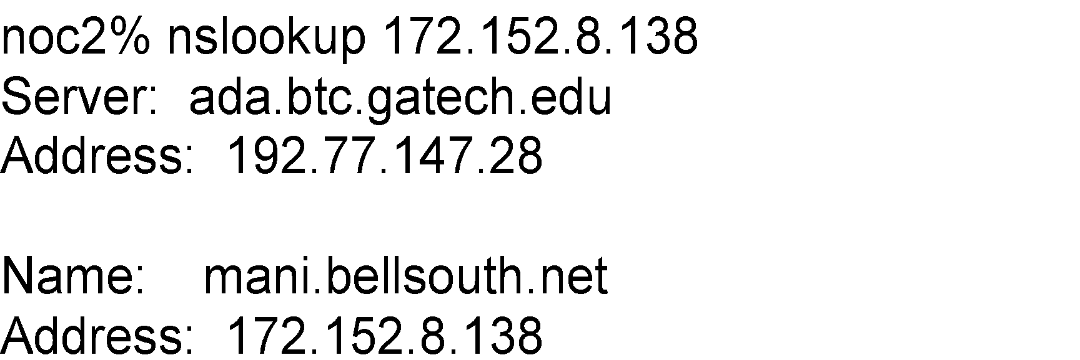
nslookup
Chapter 9 Network Management Tools, Systems, and Engineering
An interactive program for querying Internet Domain Name System servers
Converts a hostname into an IP address and vice versa querying DNS
Useful to identify the subnet a host or node belongs to
Lists contents of a domain, displaying DNS record
Available with BSD UNIX; FTP from uunet.uu.net
Available in Windows NT
  Notes
Example:
The UNIX commands, nslookup, host, and dig, are useful for obtaining names and addresses on hosts
and domain name servers. A domain name server provides the service of locating IP addresses. The
nslookup tool is an interactive program for making queries to the domain name server for translating
the host name to the IP address and vice versa. The command, by default, sends the query to the local
domain name server, but any other server can also be specified. The command dig is a more powerful
replacement for nslookup.
Notes:
*

Slide 7
Domain Name Groper: dig
Chapter 9 Network Management Tools, Systems, and Engineering
Used to gather lots of information on hosts from DNS
  Notes
Example:
[beluga]~> dig +nocomments nimbus.tenet.res.in
nimbus.tenet.res.in. 604800 IN A 203.199.255.4
tenet.res.in. 604800 IN NS volcano.tenet.res.in.
tenet.res.in. 604800 IN NS lantana.tenet.res.in.
volcano.tenet.res.in. 604800 IN A 203.199.255.3
;; Query time: 2 msec
;; SERVER: 203.199.255.3#53(203.199.255.3)
;; WHEN: Fri Mar 6 14:12:43 2009
;; MSG SIZE rcvd: 149
[beluga]~>
dig or nslookup can help when one wants to find all the hosts on a local area network (LAN).This can
be done using a broadcast ping on the LAN. We need to know the IP address to execute this command,
which we may not know. However, if we know a host name on the LAN, we could obtain the IP address
using nslookup.
The interactive command host can also be used to get the host name using the domain name server.
Notes:
*

Slide 8
Host
Chapter 9 Network Management Tools, Systems, and Engineering
Command: host
Displays host names using DNS
Available from ftp.nikhef.nl:/pub/network/host.tar.Z
  Notes
Example:
% host -a sun4-gw.cc.gatech.edu
Trying null domain
rcode = 0 (Success), ancount=1
The following answer is not authoritative:
sun4-gw.cc.gatech.edu 85851 IN A 130.207.111.100
Network Management: Principles and Practice
© Mani Subramanian and T. A. Gonsalves 2010
*
Notes:
*

Slide 9
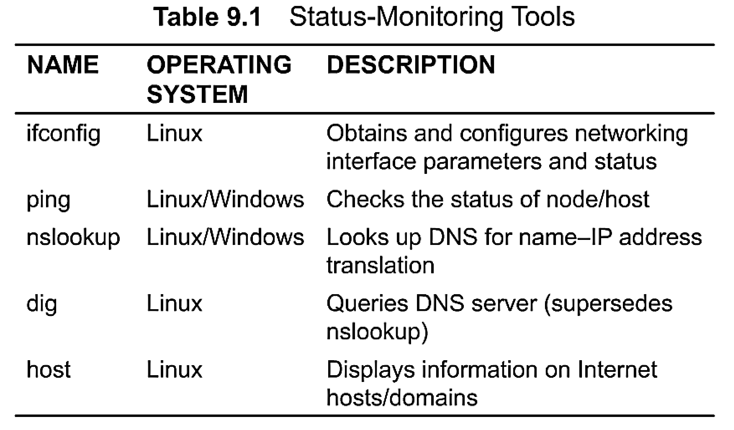
Basic Network Software Tools, are available as: Part of the Operating System and as Add-on applications that aid in obtaining network parameters or in the diagnosis of network problems
Chapter 9
Status monitoring tools
nslookup
used for querying Internet Domain Name System servers DNS
Translating a hostname into an IP address and vice versa querying DNS
Useful to identify the subnet a host or node belongs to
Dig Domain Name Groper:
Used to gather lots of information on hosts from DNS
The command dig is a more powerful replacement for nslookup.
ifConfig
Host
Used to assign/read an address to/of an interface
Option -a is to display all interfaces
Notice two interface loop-back (lo0) and Ethernet (hme0)
Displays host names using DNS
Ping
The UNIX commands, nslookup, host, and dig, are useful for obtaining names and addresses on hosts and DNS.
Based on ICMP ECHO_REQUEST message
Available on all TCP/IP stacks
Useful for measuring connectivity
Useful for measuring packet loss
Can do auto discovery of TCP/IP equipped stations on single segment
Notes:
*

Slide 10
Traffic Monitoring Tools
Chapter 9 Network Management Tools, Systems, and Engineering
Table 9.2 Traffic-Monitoring Tools
Name | Operating System | Description
ping | UNIX / Windows | Used for measuring roundtrip packet loss
bing | UNIX | Measures point-to-point bandwidth of a link
tcpdump | UNIX | Dumps traffic on a network
getethers | UNIX | Acquires all host addresses of an Ethernet LAN segment
iptrace | UNIX | Measures performance of gateways
ethereal, wireshark | Linux / Windows | Graphical tool to capture, inspect , and to save Ethernet packets
  Notes
ping and bing used to measure the propagation characteristics of the transmission path
ethereal (a.k.a. wireshark), and tcpdump (also snoop) puts the network interface in promiscuous mode and logs the data
iptrace uses NETMON program in UNIX and produces 3 types of outputs:
  IP traffic
  Host traffic matrix
  Abbreviated sampling of pre-defined number of packets
Notes:
*

Slide 11
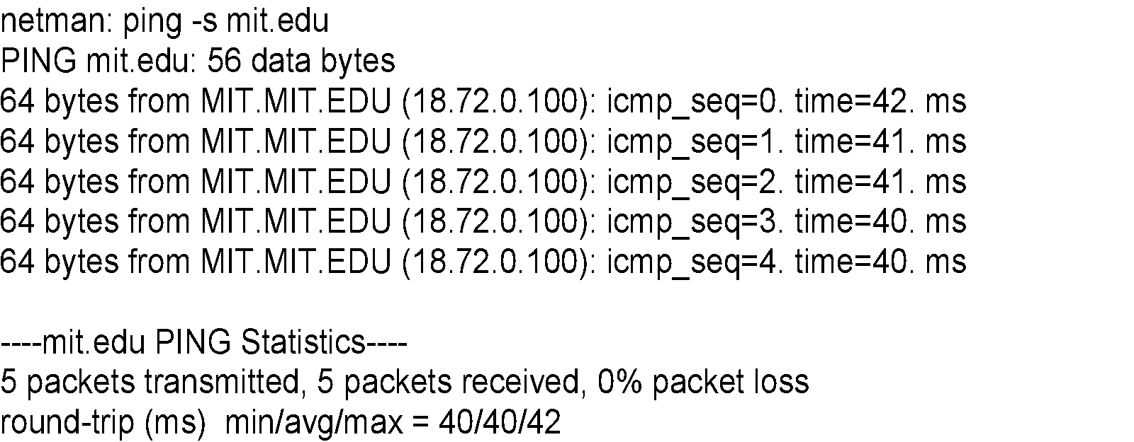
Packet Loss Measurement
Chapter 9 Network Management Tools, Systems, and Engineering
Command: ping
Many options available
Implementation varies from system to system
measuring how many of those were successfully received back, we can calculate the percentage of packet loss.
  Notes
Example:
Network Management: Principles and Practice
© Mani Subramanian and T. A. Gonsalves 2010
*
Notes:
*

Slide 12
bing
Chapter 9 Network Management Tools, Systems, and Engineering
Used to determine throughput of a link
Uses icmp_echo utility
Knowing packet size and delay, calculates bandwidth
bing L1 and L2 and the difference yields the bandwidth of link L1-L2
Bandwidth of link L1-L2 could be higher than the intermediate links.
  Notes
bing (point-to-point bandwidth ping). The bing utility determines the raw throughput of a link by calculating the difference in round-trip times for different packet sizes from each end of the link.
Notes:
*

Slide 13
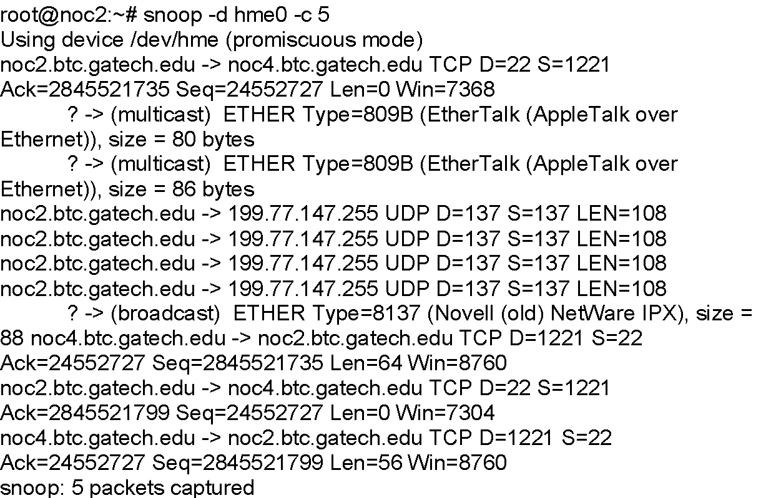
snoop
Chapter 9 Network Management Tools, Systems, and Engineering
Puts a network interface in promiscuous mode
Logs data on
  Protocol type
  Length
  Source address
  Destination address
  Reading of user data limited to super user
Promiscuous mode is a security policy which can be defined at the virtual switch
promiscuous mode can see all network traffic traversing the virtual switch
  Notes
Example: Options: -d for device interface and
-c for counts
Network Management: Principles and Practice
© Mani Subramanian and T. A. Gonsalves 2010
*
Notes:
*

Slide 14
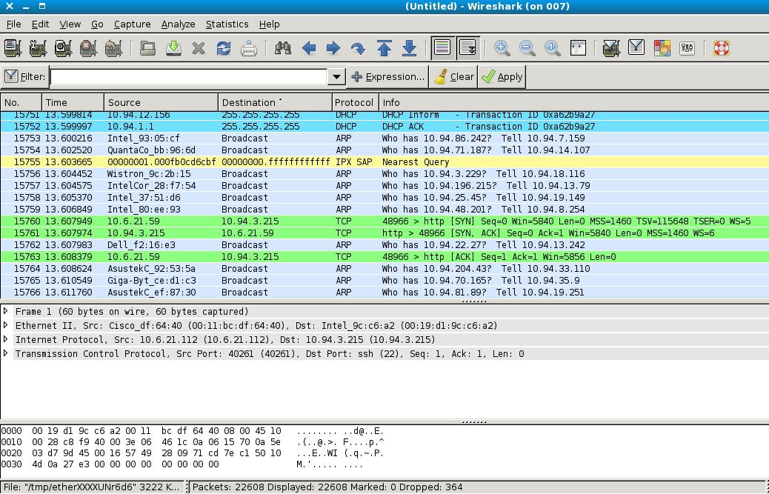
Ethereal (Wireshark)
Chapter 9 Network Management Tools, Systems, and Engineering
  Notes
tcpdump and ethereal (also known as wireshark), put a network interface in a promiscuous mode,
In which raw data are gathered from the network without any filtering, and log the data.
Notes:
*

Slide 15
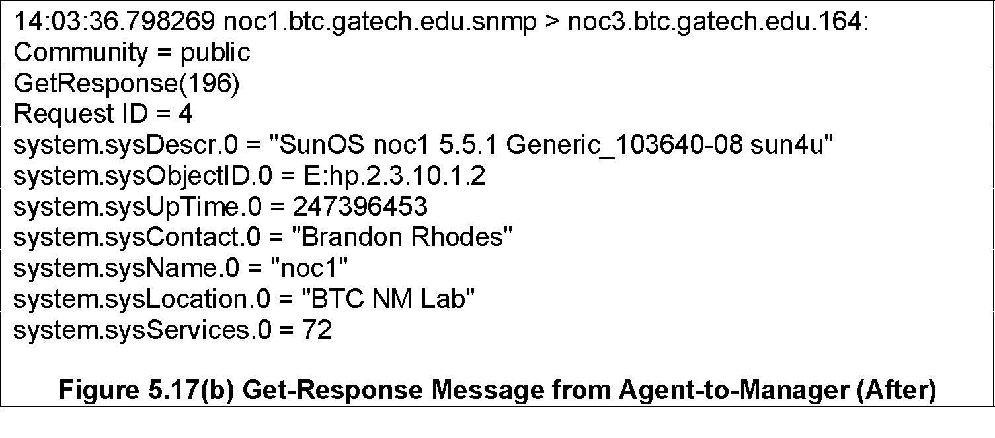
tcpdump
Chapter 9 Network Management Tools, Systems, and Engineering
Command: tcpdump
Interprets and prints headers for:
Ethernet IP ICMP
TCP UDP NFS
ND ARP Appletalk
Useful for examining and evaluating the TCP
based traffic
Available in UNIX system; FTP from ftp.ee.lbl.gov
  Notes
Example: SNMP message
Network Management: Principles and Practice
© Mani Subramanian and T. A. Gonsalves 2010
*
Notes:
*

Slide 16
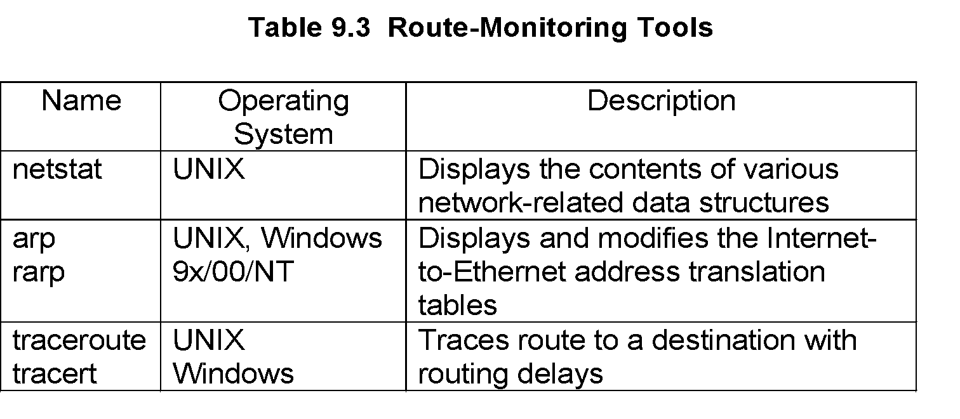
Network Routing Tools
Chapter 9 Network Management Tools, Systems, and Engineering
Table 9.3 lists three sets of route-monitoring tools. The netstat tool displays the contents of various network-related data structures in various formats, depending on the options selected.
netstat is a useful diagnostic tool for troubleshooting.
The arp tool displays and modifies the Internet-to-Ethernet address translation tables (ARP cache) used by the ARP.
traceroute (UNIX) or tracert (MS Windows), which is the basic tool used most extensively to diagnose routing problems. The tool discovers the route taken by packets from the source-to-destination through each hop. It is very useful in localizing the source of route failure. It is also useful in performance/packet delay evaluation as the result gives the delay time to each node along the route
Notes:
*

Slide 17
Network Status
Chapter 9 Network Management Tools, Systems, and Engineering
Figure 9.5 Routing Table using netstat -r
netstat -r
Routing tables
Internet:
Destination Gateway Flags Refs Use Netif Expire
Default gw.litech.net UGC 44 541550 de0
172.16.15.1 gw.litech.net UGH 0 0 de0
ah.litech.net 0:80:48:ee:74:b4 UHLW 9 2653683 de0 202
uucp.litech.net uucp.litech.net UH 0 0 lo0
sip-17.litech.net big UH 0 5551 ppp3
dip-244.litech.net gw.litech.net UGH 0 2472 de0
univers-litech-gw gw.litech.net UGH 0 47 de0
194.44.232 gw.isr.lviv.ua Ugc 0 171831 ppp9
OSPF-ALL.MCAST.NET localhost UH 1 86491 lo0
OSPF-DSIG.MCAST.NE localhost UH 1 25127 lo0
  Notes
Network Management: Principles and Practice
© Mani Subramanian and T. A. Gonsalves 2010
*
Notes:
*

Slide 18
Route Tracing
Chapter 9 Network Management Tools, Systems, and Engineering
traceroute (UNIX) or tracert (MS Windows),
Command: traceroute (UNIX) / tracert (MS TIME-EXCEED error report
Available in most UNIX OS
Windows)
ICMP Also available from uc.msc.unm.edu
Discovers route taken by packets from source to destination
Useful for diagnosing route failures
Useful for detecting bottleneck nodes
Network Management: Principles and Practice
© Mani Subramanian and T. A. Gonsalves 2010
*
Notes:
*

Slide 19
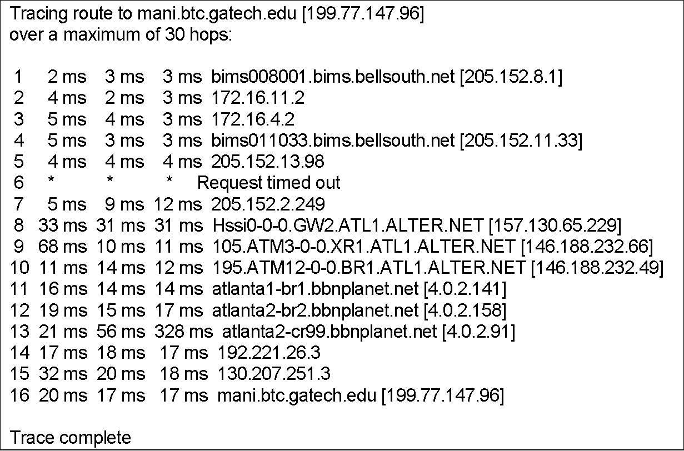
Trace Route Sample 1
Chapter 9 Network Management Tools, Systems, and Engineering
  Notes
Network Management: Principles and Practice
© Mani Subramanian and T. A. Gonsalves 2010
*
Notes:
*

Slide 20
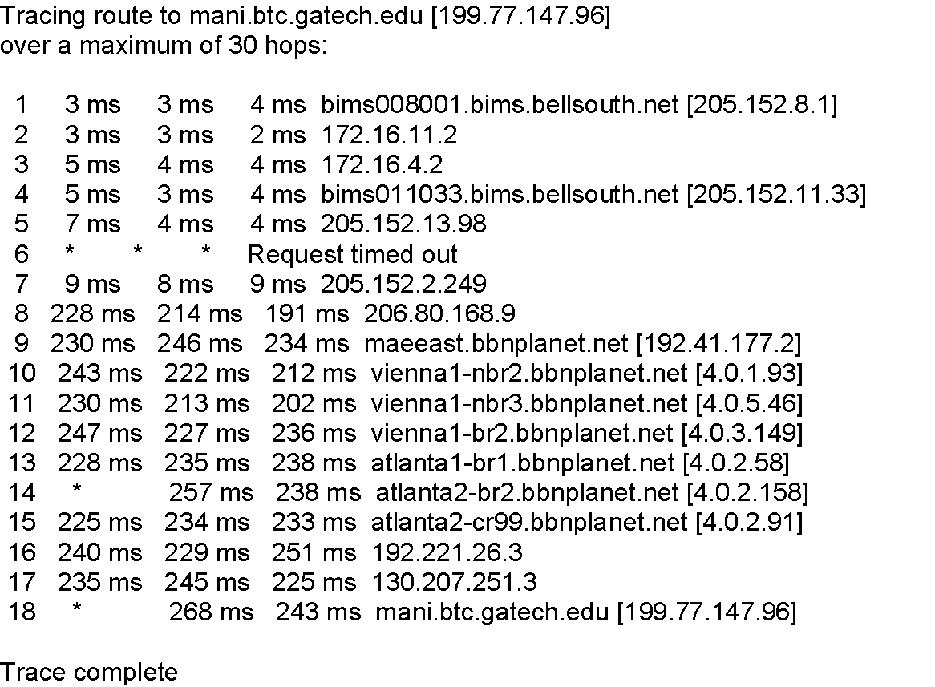
Trace Route Sample 2
Chapter 9 Network Management Tools, Systems, and Engineering
  Notes
Network Management: Principles and Practice
© Mani Subramanian and T. A. Gonsalves 2010
*
Notes:
*

Slide 21
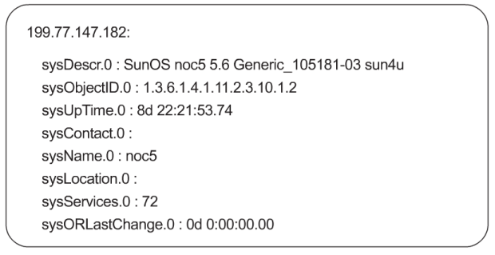
SNMP Tools
There are several tools available to obtain the MIB tree structure, as well as its values from a network element. Each of these tools has several implementations and functionality.
SNMP MIB tools are of three types: (1) SNMP MIB browser uses a graphical interface; (2) a set of SNMP command-line tools, which is primarily UNIX- and Linux/FreeBSD-based tools; and (3) Linux/FreeBSD-based tool, snmpsniff, which is useful to read SNMP PDUs.
SNMP MIB Browser.
An SNMP MIB browser is a user-friendly tool that can be accessed from public software libraries and can extract MIB-II of SNMPv1 or SNMPv2. Some can also acquire private MIB objects. You specify the host name or the IP address then information on a specific MIB object can be requested, and the response comes back with the object identifiers and values of the objects.
Figure 9.8 shows the results obtained by using a text-based browser to retrieve the system group from host 99.77.147.182.
SNMP Command-Line Tools.
There are several SNMP command-line tools available in the UNIX, Linux, or FreeBSD and Windows OS environments. Command-line tools generate SNMP messages, which are get, get-next, getbulk, set, response, and trap.
      SNMP Get Command. snmpget [options] host community objectID [objectID]
      This command communicates with a network object using the SNMP get-request message. If the SNMP agent resides on the host with the matching community name, it responds with a get-response message returning the value of the objectID. If the get-request message is invalid, the get-response message contains the appropriate error indication.
      SNMP Get-Next Command. snmpgetnext [options] host community objectID [objectID]
      The command is similar to snmpget except is especially useful to get the values of variables in an aggregate object, i.e., in a table.
      SNMP Walk Command. snmpwalk [options] host community [objectID]
      The snmpwalk command uses get-next-request messages to get the MIB tree for the group defined by the objectID specified in the request. It literally walks through the MIB.
      SNMP Set Command.
      The snmpset command sends the SNMP set-request message and receives the get-response command.
      SNMP Trap Command.
      The snmptrap command generates a trap message.
SNMP Sniff Tool.
The SNMP Sniff tool, snmpsniff, is similar to the tcpdump tool and is implemented in Linux/FreeBSD environment. It captures SNMP packets going across the segment and stores them for later analysis.

Slide 22
SNMP Tools
Chapter 9 Network Management Tools, Systems, and Engineering
SNMP command-line tools
SNMP MIB Browser with graphical interface
snmpsniff: Linux/Free BSD based tool.
Reads PDUs. It captures SNMP packets going across the segment and stores them for later analysis.
  Notes
Many tools available on public domain.
Notes:
*

Slide 23
SNMP Command Tools
Chapter 9 Network Management Tools, Systems, and Engineering
snmptest
snmpget
snmpgetnext
snmpset
snmptrap
snmpwalk
snmpnetstat
  Notes
Test tool is an interactive tool to get values of several managed objects, one at a time.
Get, Get-next and Set are the SNMP commands that we learned under SNMP architecture / messages. Execution of these will return an SNMP Response message.
SNMPWalk uses snmpgetnext to trace the entire MIB.
Network status command is used to test the status of network connections of a host.
Notes:
*

Slide 24
SNMP Get Command
Chapter 9 Network Management Tools, Systems, and Engineering
% snmpget noc5.btc.gatech.edu public system.sysDescr.0
system.sysDescr.0 = OCTET STRING: "SunOS noc5 5.6 Generic_105181-03 sun4u"
  Notes
Note that the value 0 at the end of the object id indicates that it is a single-valued scalar.
This command communicates with a network object using the SNMP gef-reguest message. The host may be either a host name or an IP address. If the SNMP agent resides on the host with the matching community name, it responds with a get-response message returning the value of the objectID.
Network Management: Principles and Practice
© Mani Subramanian and T. A. Gonsalves 2010
*
Notes:
*

Slide 25
SNMP Get Next Command
Chapter 9 Network Management Tools, Systems, and Engineering
% snmpgetnext noc5.btc.gatech.edu public interfaces.ifTable.ifEntry.ifIndex.1
interfaces.ifTable.ifEntry.ifIndex. 2 = INTEGER: 2
This command is especially useful to get the values of
variables in an aggregate object
  Notes
Network Management: Principles and Practice
© Mani Subramanian and T. A. Gonsalves 2010
*
Notes:
*

Slide 26
SNMP Set Command
Chapter 9 Network Management Tools, Systems, and Engineering
Command: snmpset host community
The snmpset command sends the SNMP set-request message and receives the
get-response command.
  Notes
Network Management: Principles and Practice
© Mani Subramanian and T. A. Gonsalves 2010
*
Notes:
*

Slide 27
Network Status
Chapter 9 Network Management Tools, Systems, and Engineering
Command: snmpnetstat Useful for finding status of network connections
% snmpnetstat noc5 public
Active Internet Connections
Proto Recv-Q Send-Q Local Address Foreign Address (state)
tcp 0 0 *.* *.* CLOSED
tcp 0 0 localhost.46626 localhost.3456 ESTABLISHED
tcp 0 0 localhost.46626 localhost.3712 ESTABLISHED
tcp 0 0 localhost.46626 localhost.3968 ESTABLISHED
tcp 0 0 localhost.46626 localhost.4224 ESTABLISHED
tcp 0 0 localhost.3456 localhost.46626 ESTABLISHED
tcp 0 0 localhost.3712 localhost.46626 ESTABLISHED
tcp 0 0 localhost.3968 localhost.46626 ESTABLISHED
tcp 0 0 localhost.4224 localhost.46626 ESTABLISHED
tcp 0 0 noc5.41472 noc5.4480 ESTABLISHED
tcp 0 0 noc5.41472 noc5.4736 ESTABLISHED
tcp 0 0 noc5.4480 noc5.41472 ESTABLISHED
tcp 0 0 noc5.4736 noc5.41472 ESTABLISHED
  Notes
Network Management: Principles and Practice
© Mani Subramanian and T. A. Gonsalves 2010
*
Notes:
*

Slide 28
SNMP Browser
Chapter 9 Network Management Tools, Systems, and Engineering
Command: snmpwalk host community [variable name]
Uses Get Next Command
Presents MIB Tree
  Notes
199.77.147.182:
sysDescr.0 : SunOS noc5 5.6 Generic_105181-03 sun4u
sysObjectID.0 : 1.3.6.1.4.1.11.2.3.10.1.2
sysUpTime.0 : 8d 22:21:53.74
sysContact.0 :
sysName.0 : noc5
sysLocation.0 :
sysServices.0 : 72
sysORLastChange.0 : 0d 0:00:00.00
Figure 9.8 MIB Browser Example (text based) for System Group
Network Management: Principles and Practice
© Mani Subramanian and T. A. Gonsalves 2010
*
Notes:
*

Slide 29
SNMP Sniff
Chapter 9 Network Management Tools, Systems, and Engineering
snmpsniff -I interface
A tool in Linux / FreeBSD environment
Puts the interface in promiscuous mode and captures snmp PDUs.
Similar to tcpdump
  Notes
It captures SNMP packets going across the segment and stores them for later analysis.
Notes:
*

Slide 30
2. Traffic Monitoring Tools
Chapter 9
3. Network Routing Tools
Name | Description
ping | Used for measuring roundtrip packet loss
bing | Measures point-to-point bandwidth of a link Used to determine throughput of a link Uses icmp_echo utility
tcpdump (snoop) | Dumps traffic on a network. Useful for examining and evaluating the TCP based traffic
getethers | Acquires all host addresses of an Ethernet LAN segment
iptrace | Measures performance of gateways produces 3 types of outputs: IP traffic Host traffic matrix Abbreviated sampling of pre-defined number of packets
ethereal, wireshark | Graphical tool to capture, inspect , and to save packets
netstat is a useful diagnostic tool for troubleshooting.
The arp tool displays and modifies the Internet-to-Ethernet address translation tables (ARP cache) used by the ARP.
traceroute (UNIX) or tracert (MS Windows), which is the basic tool used most extensively to diagnose routing problems. Is useful for:
  Discovers route taken by packets from source to destination
  Useful for diagnosing route failures
  Useful for detecting bottleneck nodes
SNMP Tools
ping and bing used to measure the propagation characteristics of the transmission path
ethereal (a.k.a. wireshark), and tcpdump (also snoop) puts the network interface in promiscuous mode and logs the data
SNMP command-line tools
SNMP MIB Browser with graphical interface
snmpsniff: Linux/Free BSD based tool.
Reads PDUs. It captures SNMP packets going across the segment and stores them for later analysis.
Promiscuous mode is a security policy which can be defined at the virtual switch
promiscuous mode can see all network traffic traversing the virtual switch
Command: snmpnetstat Useful for finding status of network connections
Notes:
*

Slide 31
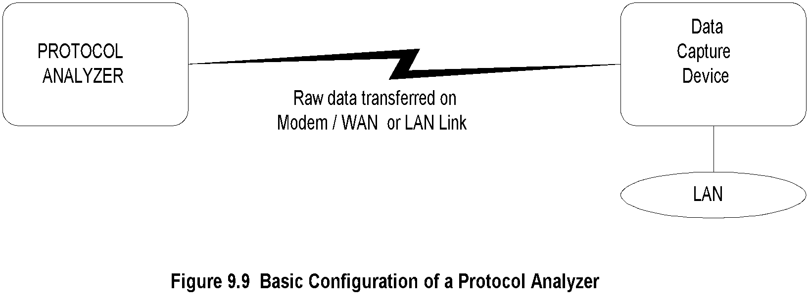
Protocol Analyzer
Chapter 9 Network Management Tools, Systems, and Engineering
  Notes
Analyzes data packets on any transmission line including LAN
Measurements made locally or remotely
Probe (data capture device) captures data and transfers to the protocol analyzer
Data link between probe and protocol analyzer either dial-up or dedicated link or LAN
Protocol analyzer analyzes data at all protocol levels
Notes:
*

Slide 32
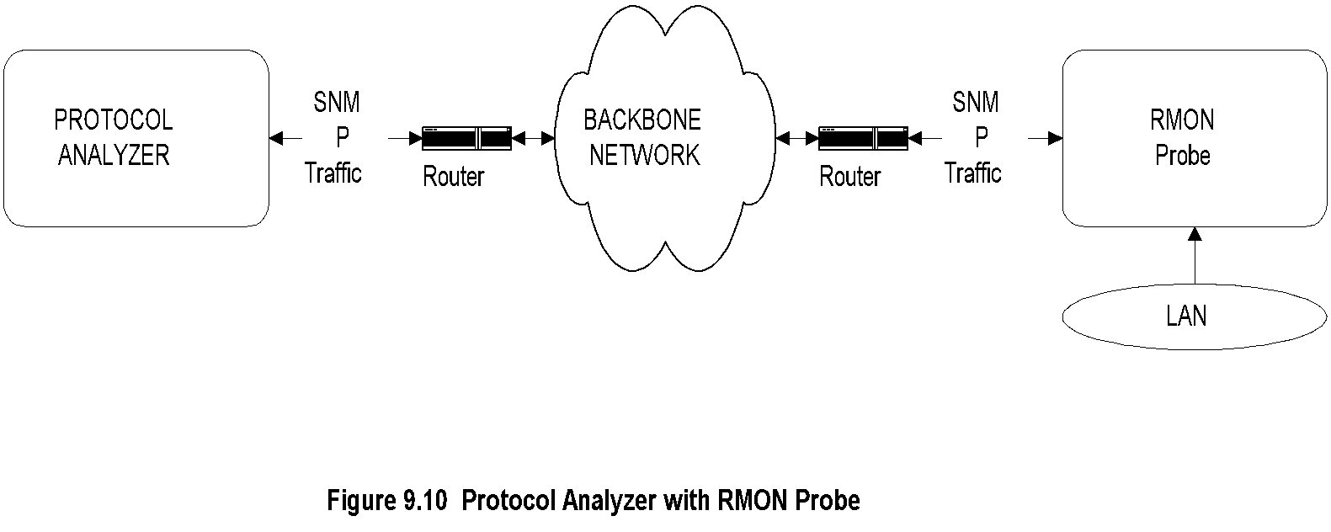
RMON Probe
Chapter 9 Network Management Tools, Systems, and Engineering
  Notes
Network Associates Sniffer
  Stand-alone and Networked
HP NetMetrix / HP OpenView
  Communication between probe and analyzer is using SNMP
Data gathered and stored for an extended period of time and analyzed later
Used for gathering traffic statistics and used for configuration management for performance tuning
A protocol analyzer functioning as a remote-monitoring analyzer collects data using an RMON probe.
Notes:
*

Slide 33
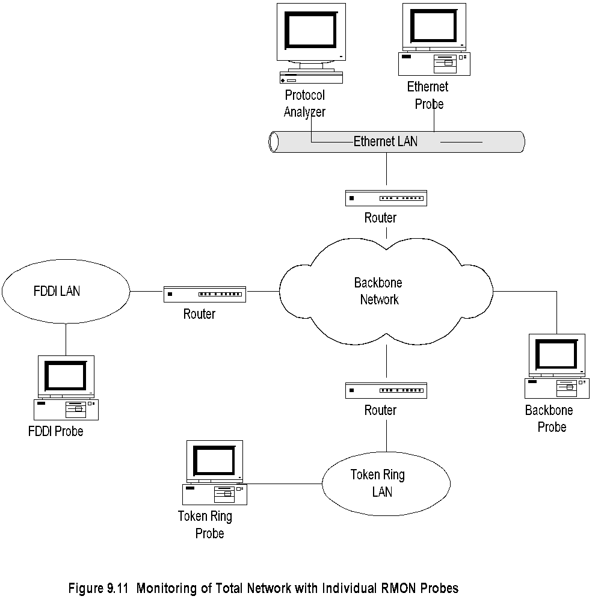
Network Monitoring with RMON Probe
Chapter 9 Network Management Tools, Systems, and Engineering
Notes:
*

Slide 34
Network Statistics
Chapter 9 Network Management Tools, Systems, and Engineering
Protocol Analyzers
RMON Probe / Protocol analyzer
MRTG (Multi router traffic grouper)
Home-grown program using tcpdump
  Notes
One of the best ways to gather network statistics is to capture packets traversing network segments
or across node interfaces in a promiscuous mode. We have learned that protocol analyzers do just that.
Thus, they are good tools to gather network statistics. Another way to gather network statistics is to
develop a simple application using a function similar to tcpdump, using a high-performance network
interface card and processor, and analyze the data for the required statistics. After all, that is the basis on
which protocol analyzers are built.
Notes:
*

Slide 35
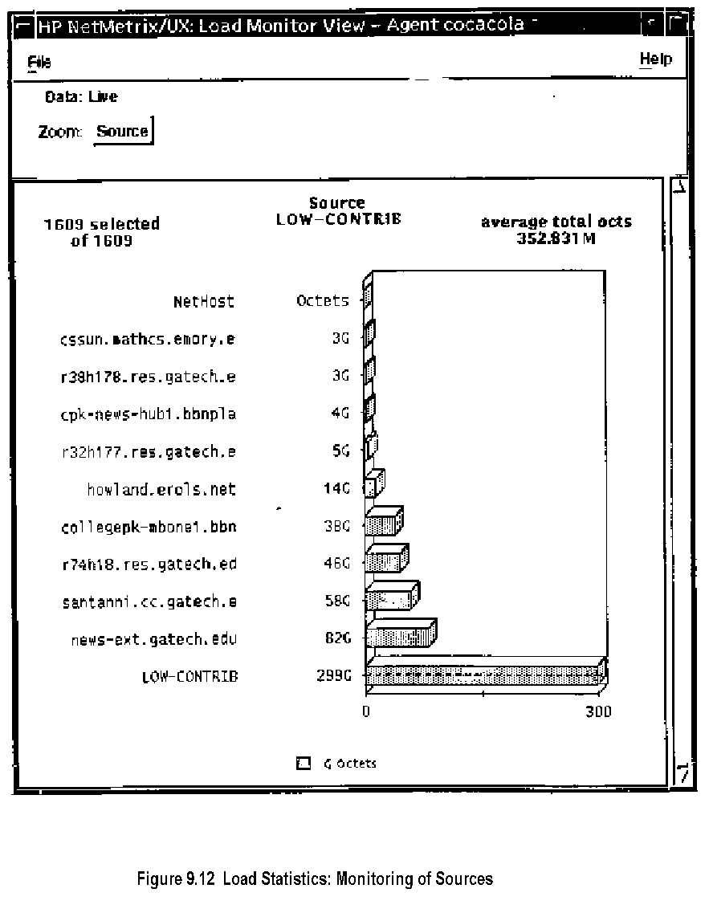
Traffic Load: Source
Chapter 9 Network Management Tools, Systems, and Engineering
Traffic Load Monitoring
Traffic load monitoring can be done based on the source, the destination, and the source-destination pair.
We may want to balance the traffic load among the various LAN segments, in which case we need to measure the total traffic in each network segment or domain.
Data for traffic monitoring can be sampled at the data link layer using the RMON1 MIB history group. Traffic relevant to a host, either as source or as a destination, is available in the host group.
Notes:
*

Slide 36
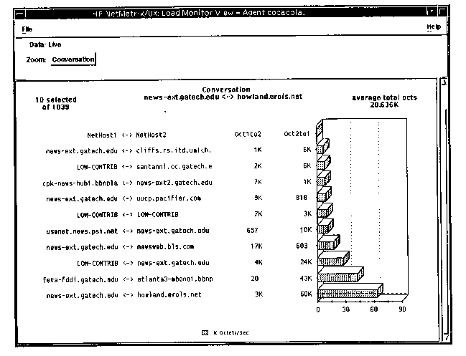
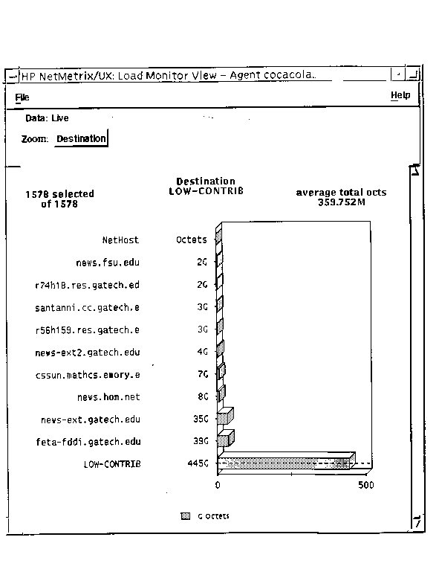
Traffic Load: Destination
Chapter 9 Network Management Tools, Systems, and Engineering
Traffic Load: Conversation
Figure 9.13 Load Statistics: Monitoring of Destinations
Notes:
*

Slide 37
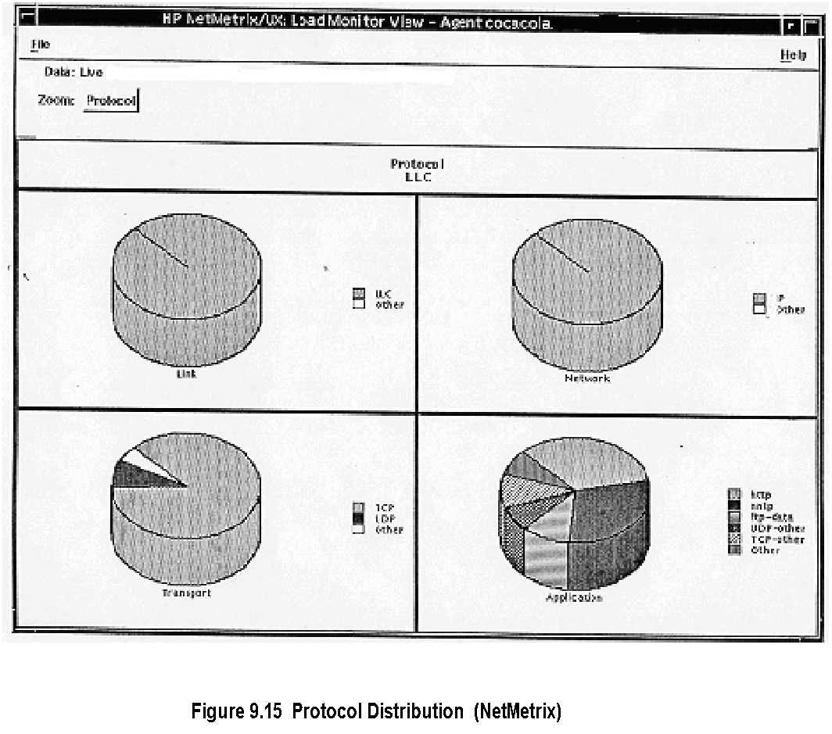
Protocol Distribution
Chapter 9 Network Management Tools, Systems, and Engineering
Packets can be captured by data capture devices based on the filter set for the desired criteria. From the captured data, we can derive protocol statistics of various protocols at each layer of the OSI Reference Model. This is very useful at the application layer level. We can obtain the traffic load for different applications such as file transfer (FTP), Web data (HTTP), and news groups (NNTP). This information can be used for bandwidth management of real-time and non-real-time traffic.
Figure 9.15 shows the distribution of protocols at the data link (top left corner), network (top right corner), transport (bottom left corner), and application (bottom right corner) layers, obtained using NetMetrix LanProbe and a protocol analyzer. Data link and network layers show 100% LLC and IP protocols. The majority of the transport layer protocol packets belong to TCP and the next in order is UDP. The other category is undefined. At the application layer(s), the distribution contains HTTP (Web protocol), NNTP (news protocol), FTP-data, UDP-other, TCP-other, and undefined other. The Georgia Tech internet backbone network in which the measurements were made carries a complex variety of protocol traffic including multimedia traffic and next generation Internet traffic.
Notes:
*

Slide 38
MRTG
Chapter 9 Network Management Tools, Systems, and Engineering
Multi Router Traffic Grouper (Oeticker and Rand)
www.ee.ethz.ch/stats/mrtg/
Generates graphic presentation of traffic on Web
  Daily view
  Weekly view
  Monthly view
  Yearly view
  Notes
The MRTG is a tool that monitors traffic load on network links, It generates a live visual representation of traffic data by reading the SNMP traffic counters on routers and creates graphs that are embedded into Web pages. These can be monitored using any Web browser
Notes:
*

